Slide 1
Constellation Detection
Limin Ding

Slide 2
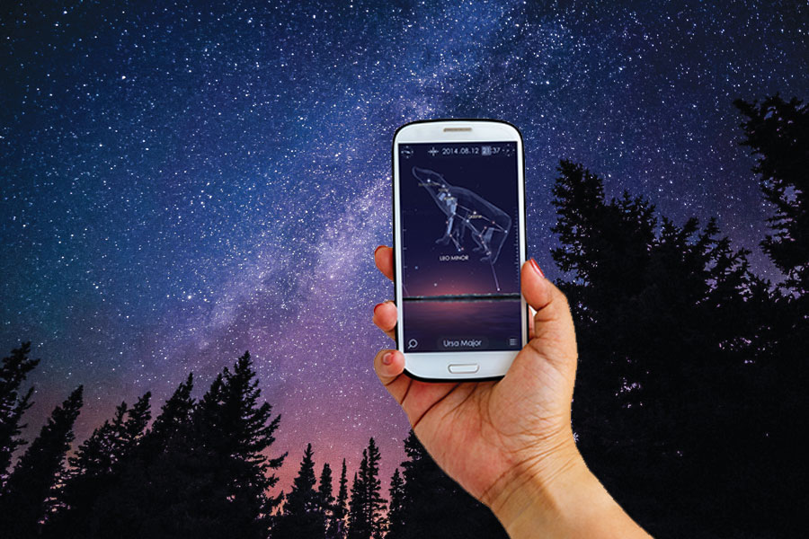
Idea
Mainstream stargazing app
Project a star map on the phone based on your GPS location and time.
not user-friendly to beginner
My idea
Identify constellations
directly from a picture
from camera in realtime (future goal)
More beginner-friendly

Slide 3
Project Overview
Task:
Identify the constellation directly from image
Dataset:
Stargazer(kaggle) https://www.kaggle.com/datasets/theprakharsrivastava/stargazer/data

Slide 4
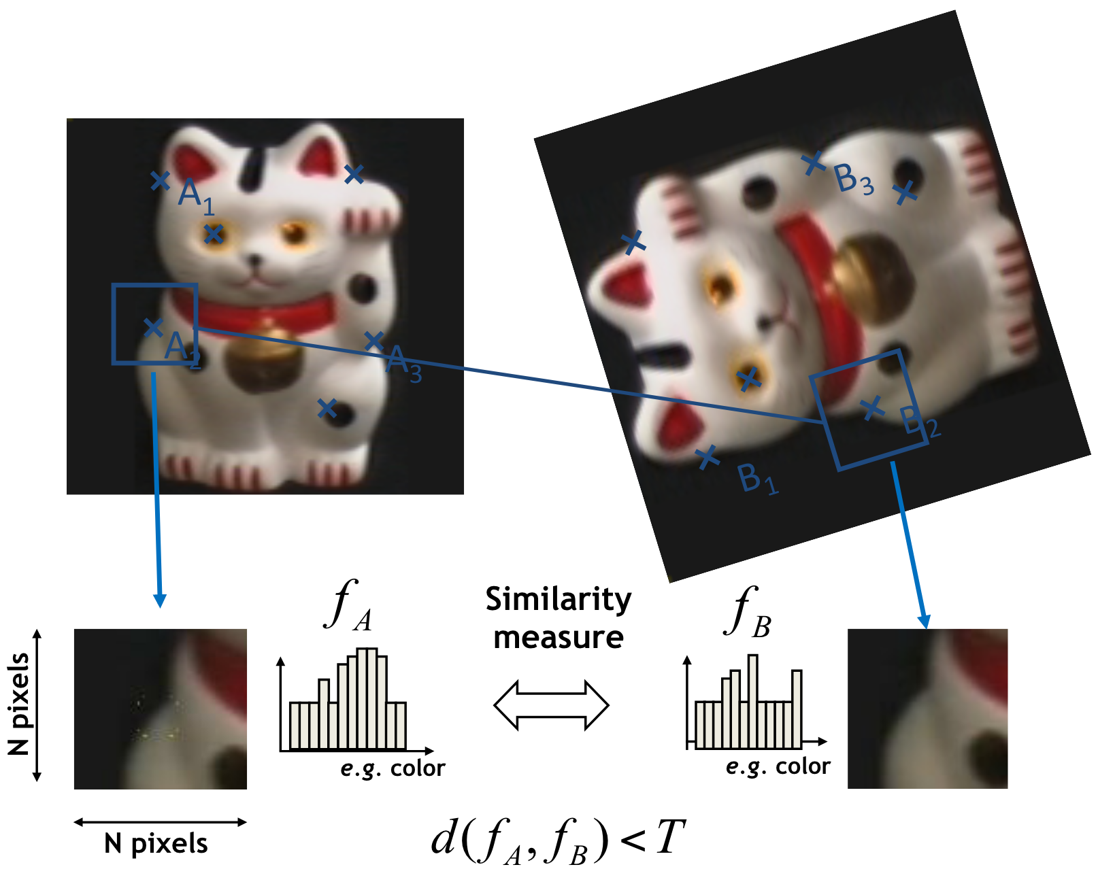
Keypoints Detection and Matching
Feature detection:
Find keypoint location
Feature description:
Compute keypoint descriptor
Feature matching:
Find corresponding key points in a pair of images

Slide 5

Feature detection
Find keypoint location(stars)
Using gaussian filter to reduce noise
Image binarization with thresholding
Applying Hough Circle Transform to identify stars.

Slide 6
Feature description
Compute keypoint descriptor
First thought:
Using relative distance as the descriptor of each point
Compute pairwise Euclidean distances between keypoints.
Sort and select the k-nearest neighbors for each keypoint.
Normalize distances by the average of the k-nearest distances.

Slide 7
Feature matching
Find corresponding key points in a pair of images
First thought:
Match descriptors using Euclidean distance (L2 norm)
Filter matches based on a threshold ( < 0.3 )
using RANSAC to find the best match with max inliers

Slide 8
Refinement
Adding angle descriptors
Compute relative angles between keypoints and their nearest k neighbor pairs
Use arctan2 to determine the angle
arctan(y/x) only provides angles in first and fourth quadrants.
arctan2(y, x) covers the full range
Instead of RANSAC inliers, finding the best matching using min average angle distance

Slide 9
Future Goal
Finding a more robust feature detector
Deploy the model on a Android app

Slide 10
Questions?

